Slide 1


U-Thryv
Track what shapes you. Basically your life, but sorted.
Team Members: Nashit Budhwani Udbhav Sharma
Om Prasad Astha Anand Juhi Kumari

Slide 2


Slide 3
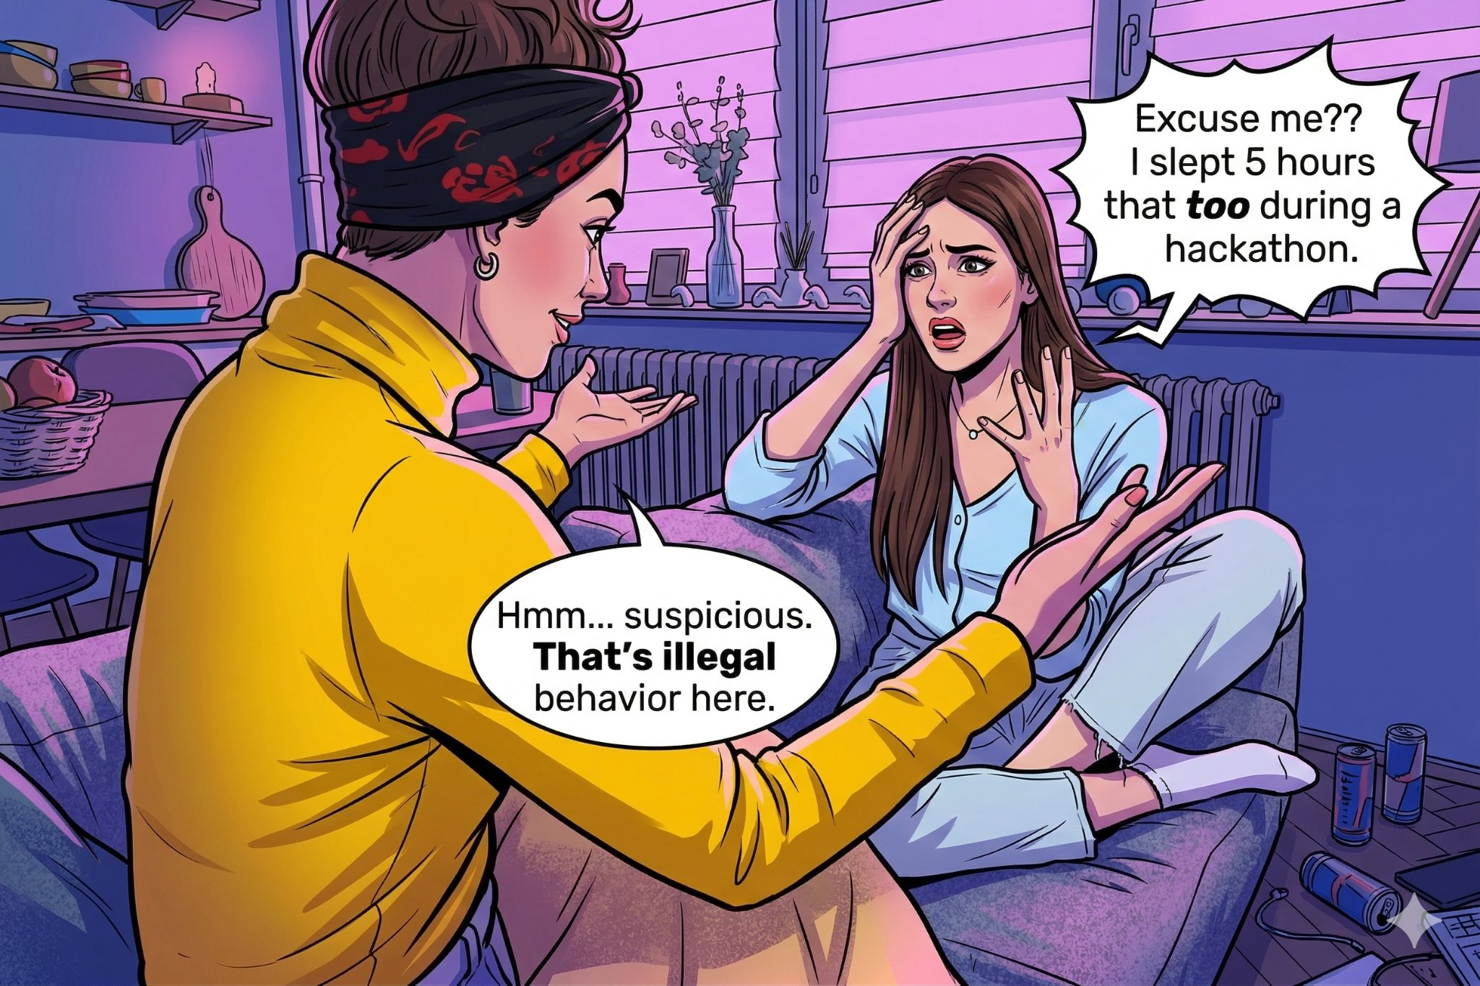

Slide 4
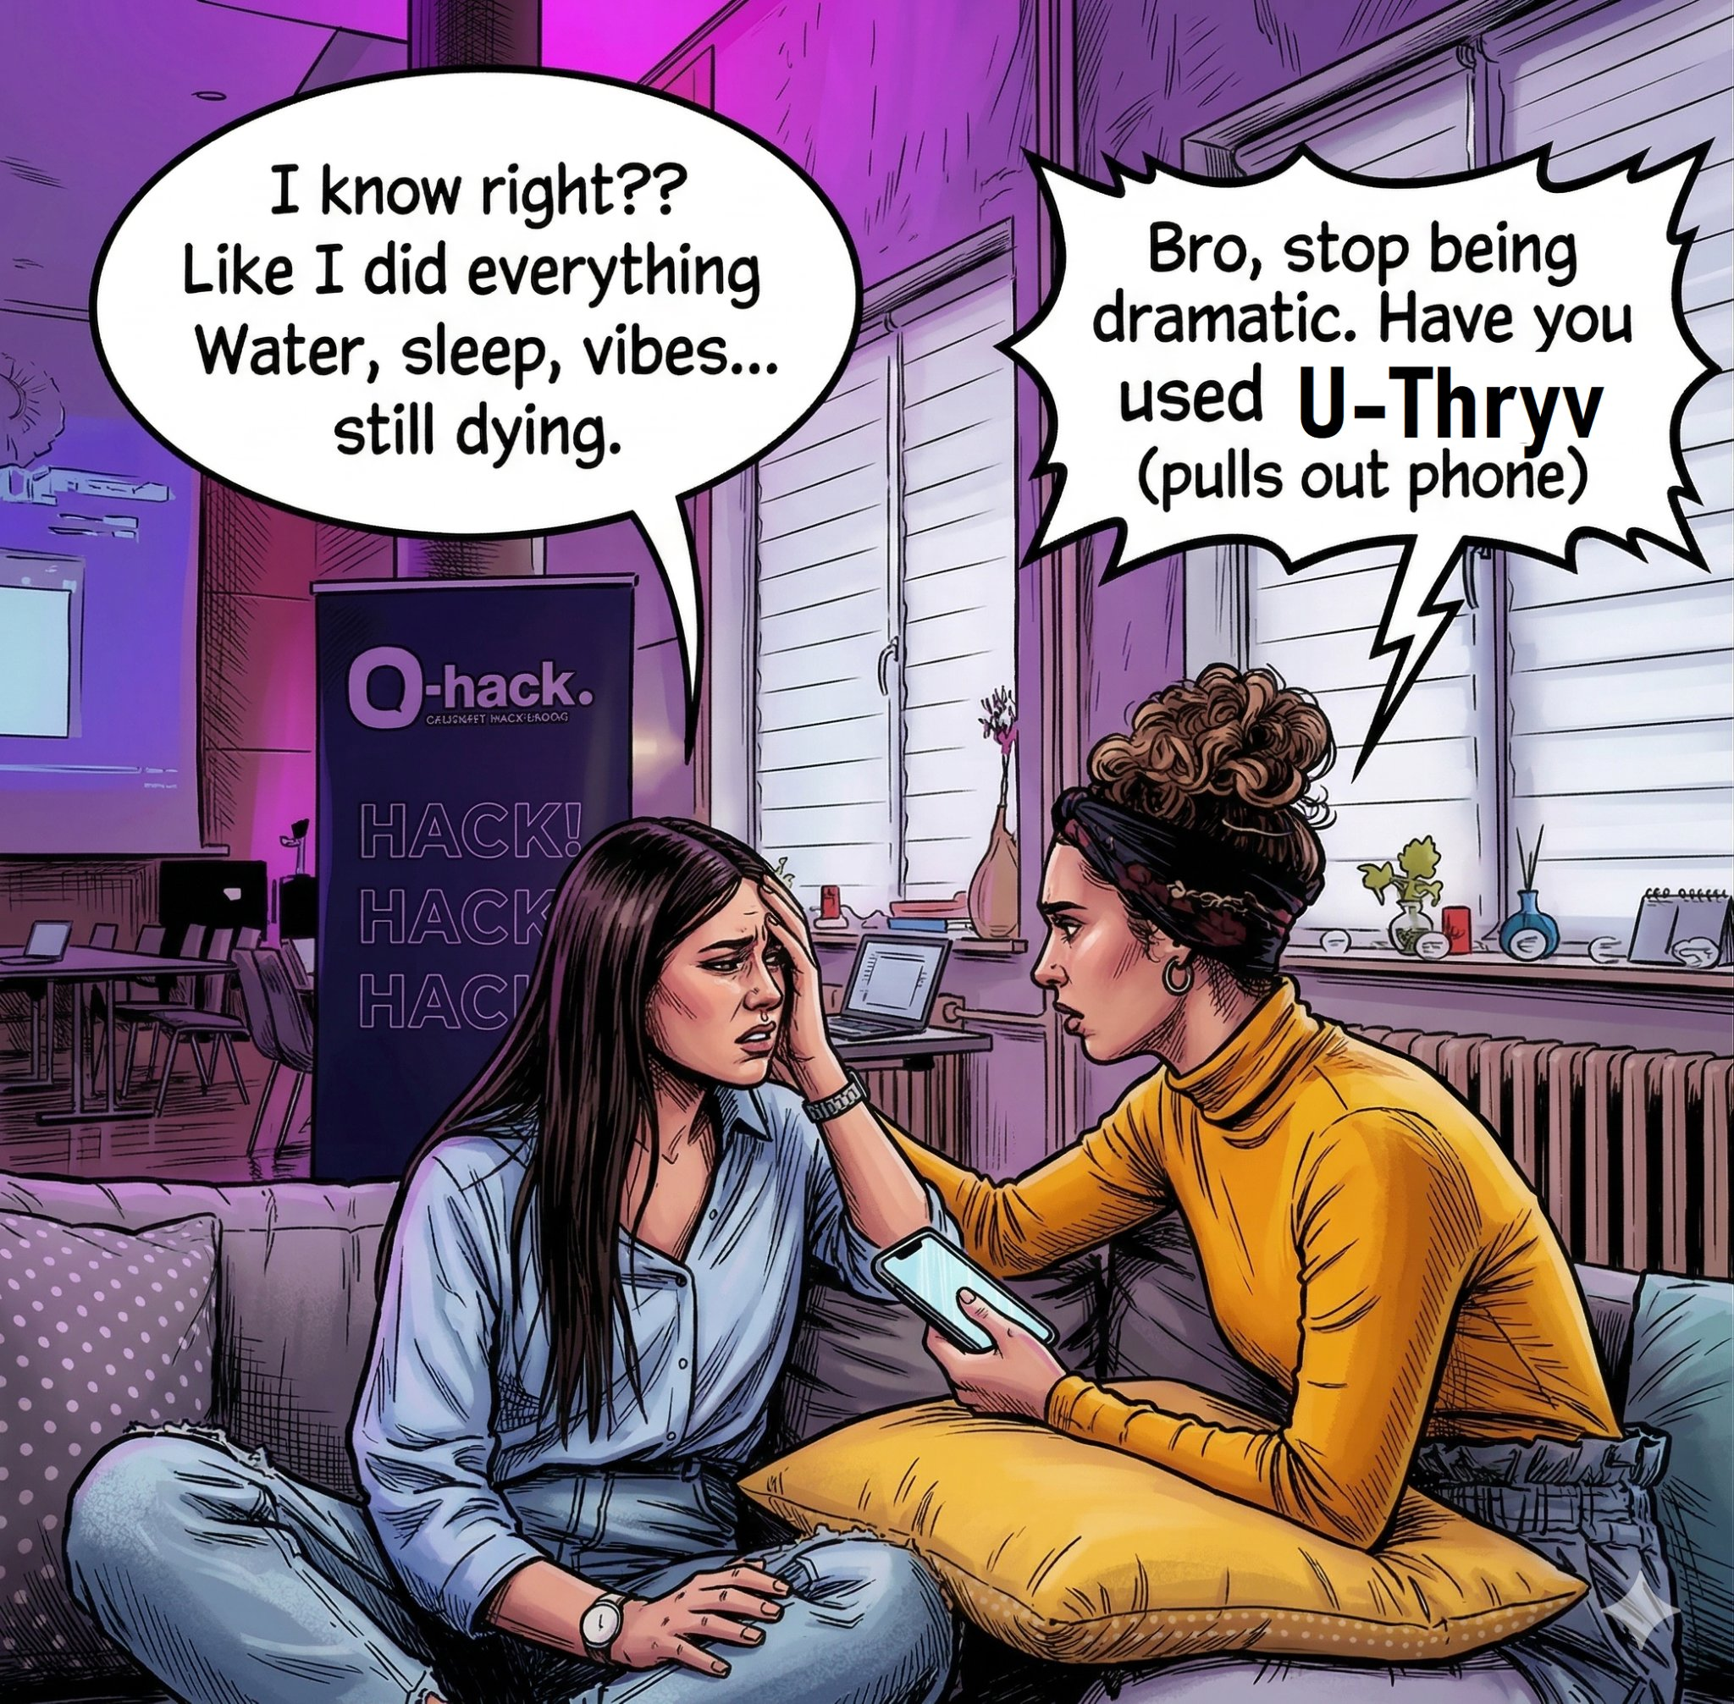

Slide 5


Slide 6
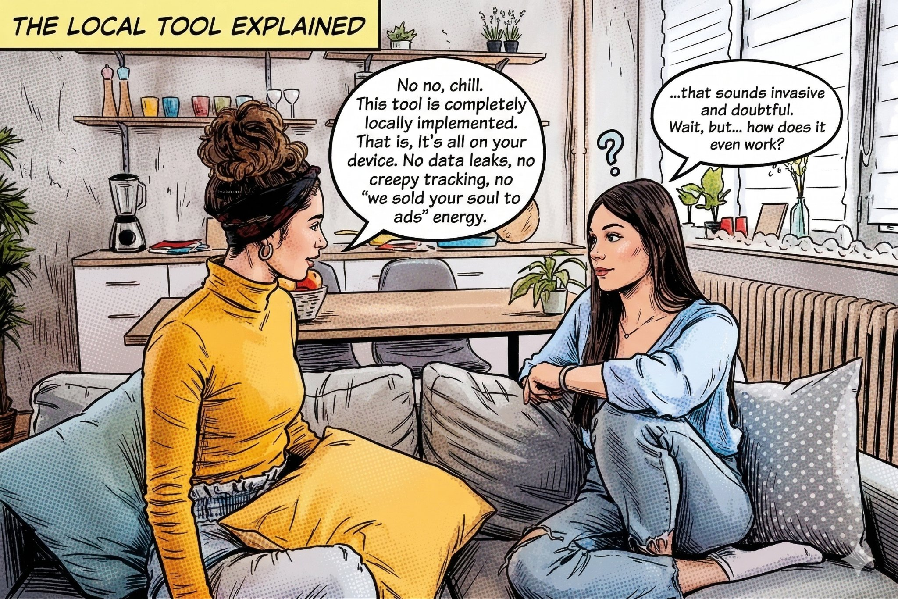

Slide 7
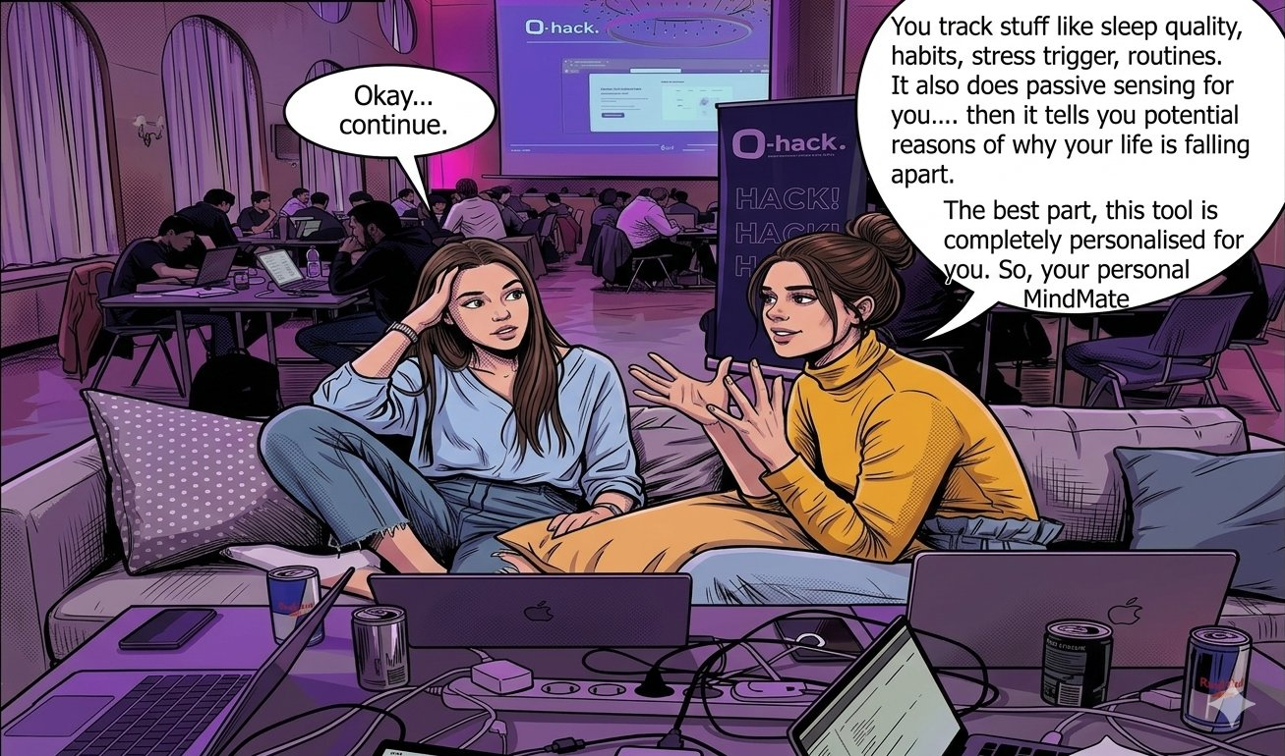

Slide 8
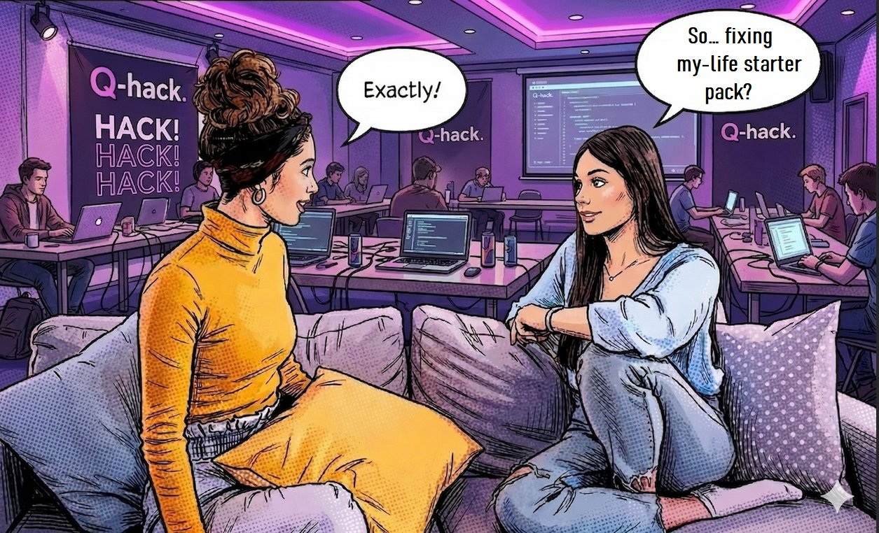

Slide 9
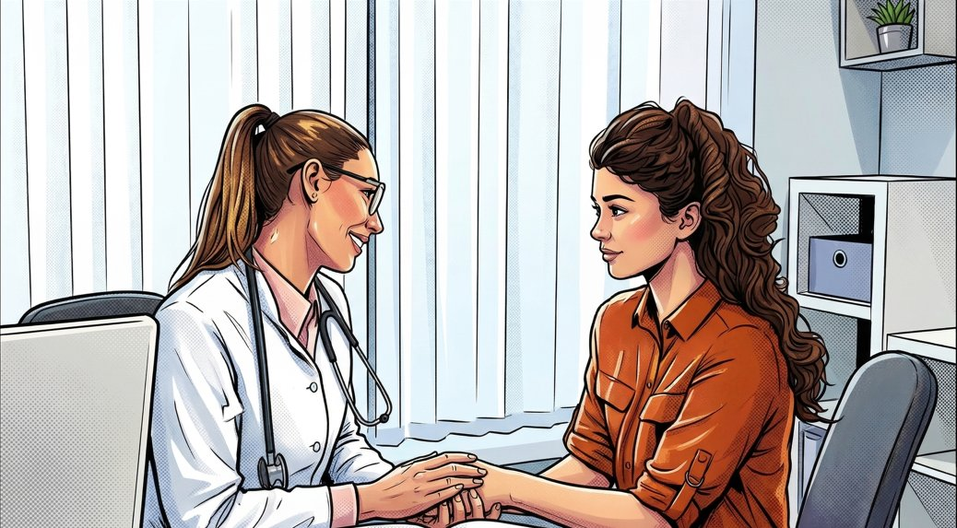
Why U-Thryv
Connecting …
Physical Health + Lifestyle
with Mental Health
User with self
Doctor with Patients
Notes:
A doctor can’t really understand you in the 5-8 minutes that they spend with you. They don’t know you!
Do you really know how your shape every little problem or symptom that you face everyday? Since you are not a doctor, so…. probably no.
You know about the body and the brain connection, but can you really track it? Or are you all on your own….?

Slide 10
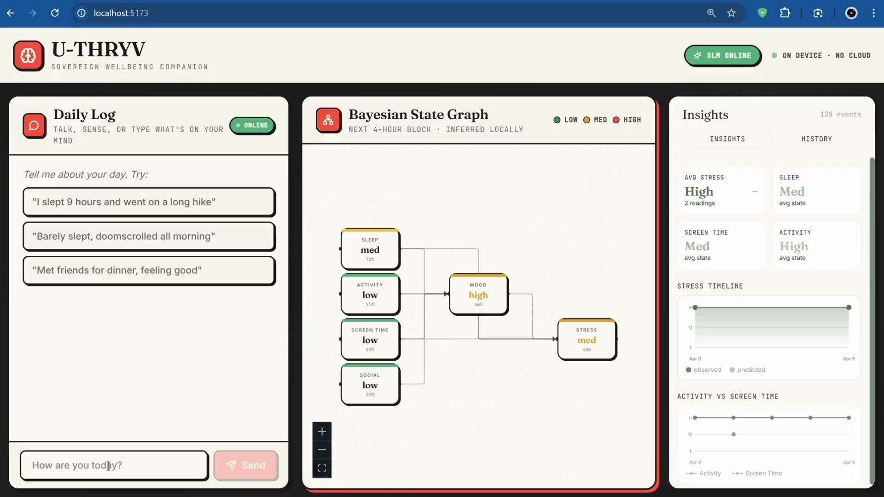

Slide 11
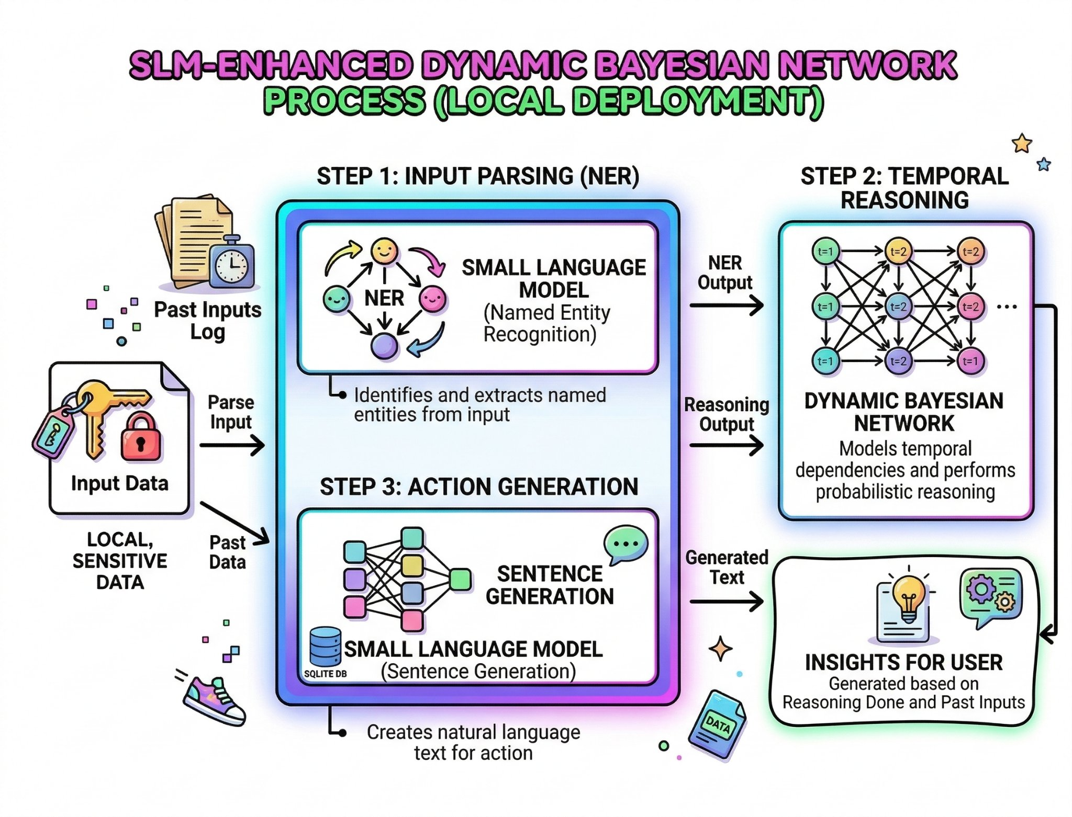

Slide 12
Questions Please…

